Slide 1
Magic Item Creator
Team 6 - Evan Rohde, Ian Burgess, Ian Kaiserman, Neriah Graham

Slide 2


The Vision
TTRPG/Worldbuilding magic item creation tool for everyone
Original vision - pixel art
Anyone can pick it up
Flexible and broad features

Slide 3
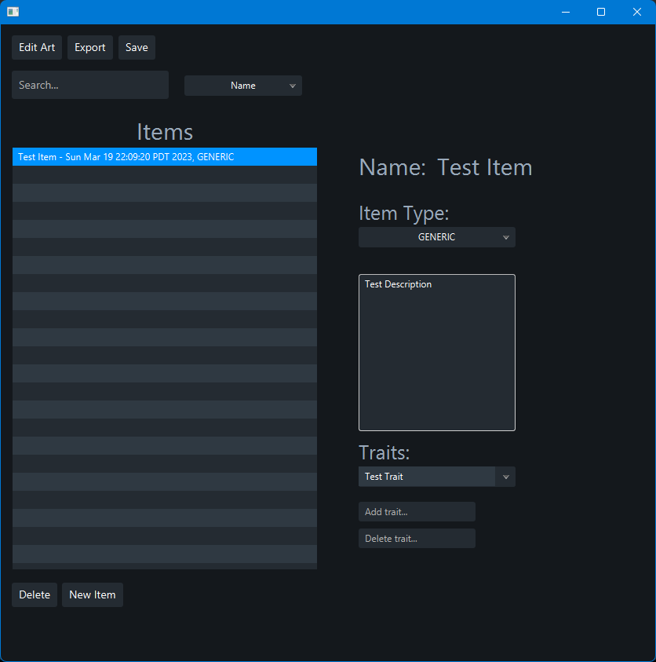
The Goals
List of created items
Saves to local machine
Loads from existing files
Items have various properties
Name, description, etc.
Flexibility in how properties are used
Navigation
Easy to pick up UI
Ability to search
Full control of user-created content
Verify saving before exiting
Visual aids
Creation, editing, exporting of pixel art
PDF exporting
Notes:
R3 - Create new magic item, R6 - Display items list
R5 - Save to database
R8 - Load item
R14 - Item object
R4 - Item traits
(Ability to add, modify, delete, etc)
(General app navigation)
R7 - Search for item
(General UI design)
R9 - Delete from DB
(PDF and Pixel Art)
R11 - Create item art, R12 - Modify item art
R10 - Export to PDF

Slide 4
The Process
Three main phases of development
Making it work - Building the backend functionality
Making it usable - Creating the UI and linking the backend to it
Making it work (again) - Addressing various bugs, unintended interactions, and more

Slide 5
Making it work
Magic Item Object
Stores name, description, art, traits for each individual item
Can be individually manipulated
Magic Item Helper
Manages collection of user’s items (list, searching, sorting)
Interfaces between UI and database
Responsible for reading/writing local machine files into/from the program
PDF Export
Leverages PDFBox for fetching data from item objects and rendering PDF
Building the backend

Slide 6
Making it work
Art Editing Window
Tile System
Placing and Deleting
Key Handling
JavaFX
Easy to learn application platform for UI development with Java
Hooking up backend into eventual frontend with JavaFX
Building the backend

Slide 7
Making it usable
PDF Export
Fairly straightforward, linking UI elements to backend functions
Art Editor Controls
Game Window
Grid Manipulation
Saving and Loading
UI
Linking backend to frontend
Creating an easy-to-use UI with user-friendly navigation
CSS styling
Creating the UI

Slide 8
Making it work (again)
Initial problems with Maven
Lots of null checking in the UI itself
Navigating around unexpected UI interactions
Many times fixing one UI issue led to another related issue
UI Listeners were really touchy about handling changes in lists and boxes
Bug fixes, bug fixes, bug fixes

Slide 9
Demo Video!

Slide 10
Questions?

